Slide 1
Story 5 Alex Khaykin 11/02/2023

Slide 2
INTRODUCTION
Historic data seems to indicate the average temperature on earth has been increasing over tome. Further, it has been widely reported and believed that the increase in global temperature is responsible for the increased severity, intensity, and occurrence of cyclonic storms (Hurricanes, Typhoons, and Tornadoes). For this assignment I will utilize the Average Maximum Temperature based on NYC temperatures data from The Climate explorer, for the years 1950 through 2013. As well as a frequency count of Tornado occurrences, from The National Centers for Environmental Information, the frequency count of Hurricane occurrences from United States Environmental Protection Agency, Tornadoes intensity from NOAA National Weather Services, and Hurricane intensity from NOAA Hurricane Research Division. Has the increase in Average Daily Maximum Global temperatures influenced the frequency of occurrence and intensity of these storms?

Slide 3
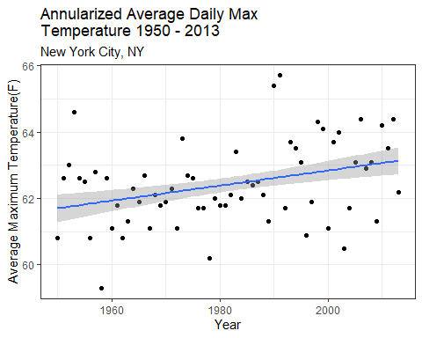
Data from CRT Climate Explorer, a clear but mild positive increase of Average Daily Maximum global temperatures based on NYC records for the years 1950 – 2013.

Slide 4
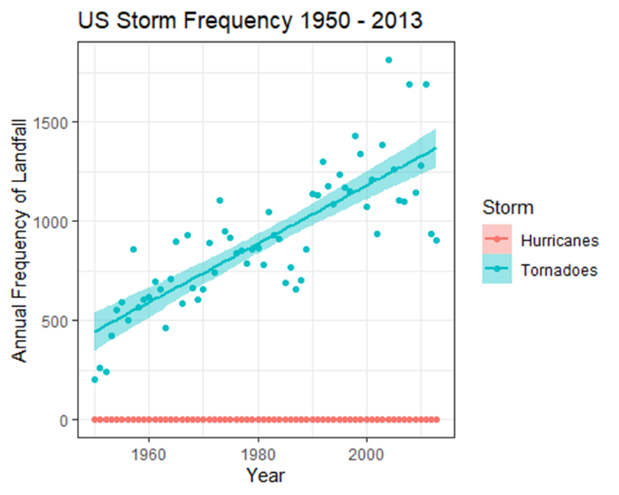
Data from National Centers from Environmental Information (NOAA ), shows a clear positive increase in Tornado Landfall Frequency between the years 1950 – 2013. Data from United States Environmental Protection Agency (EPA), shows no increase in Hurricane Landfall Frequency between the years 1950-2013.

Slide 5
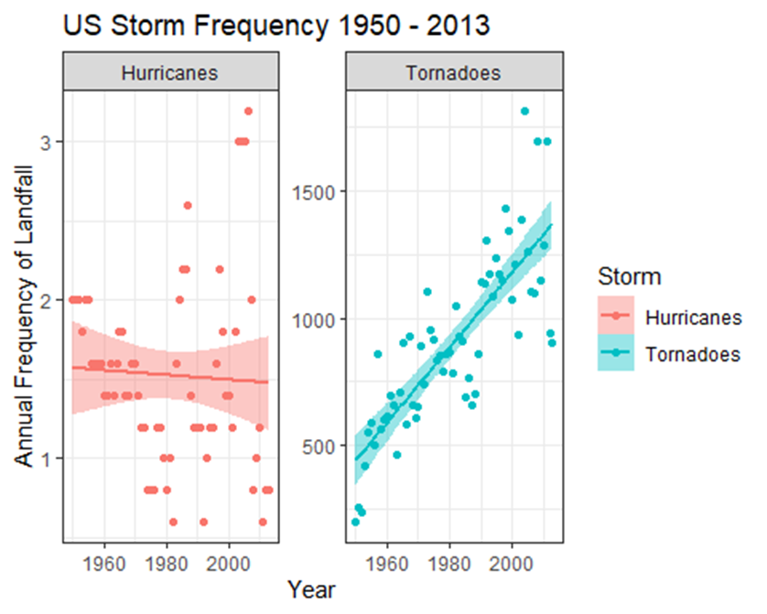
Data from National Centers from Environmental Information (NOAA ), shows a clear positive increase in Tornado Landfall Frequency between the years 1950 – 2013. Data from United States Environmental Protection Agency (EPA), shows no increase in Hurricane Landfall Frequency between the years 1950-2013.

Slide 6
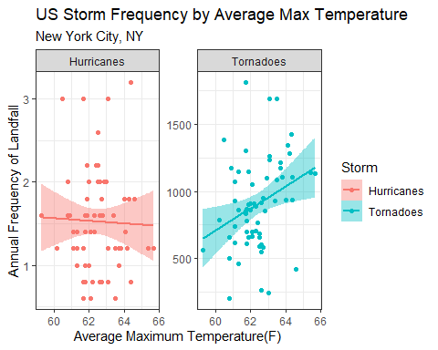
Data from National Centers from Environmental Information (NOAA ), shows a clear positive increase in Tornado Landfall Frequency between the years 1950 – 2013. Data from United States Environmental Protection Agency (EPA), shows no increase in Hurricane Landfall Frequency between the years 1950-2013.

Slide 7
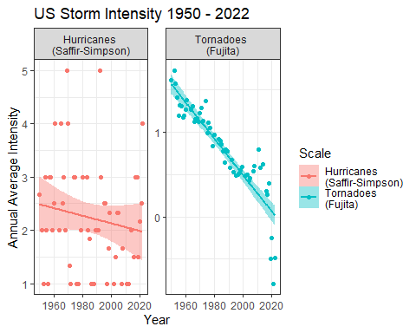
Data from NOAA’s National Weather Services and The Hurricane Research Center shows a clear negative or decrease in Tornado and Hurricane Intensities based on the Saffir-Simpson scale and Fujita scale between the years 1950 – 2022.

Slide 8
CONCLUSION
The data has shown a clear pattern of average daily maximum temperature increase from 1950 through 2013. Also, it appears there is a significant increase in the frequency of landfall for Tornadoes in the United States and marginal increase in the frequency of Hurricane landfall in the United States. However, the data clearly shows that while the frequency and count of occurrence of these storms have increased at the same time the severity of these storms have decreased. There is a very strong negative correlation of intensity for Tornadoes, and a mildly negative intensity correlation of Hurricanes for the years 1950 though 2022.
SOURCES
Tornadoes Frequency of Landfall Count https://www.ncei.noaa.gov/access/monitoring/tornadoes/time-series/ytd/12?mean=true
Hurricane Frequency of Landfall Counts https://www.epa.gov/climate-indicators/climate-change-indicators-tropical-cyclone-activity
Tornado Intensity https://www.spc.noaa.gov/wcm/
Hurricane Intensity https://www.aoml.noaa.gov/hrd/hurdat/All_U.S._Hurricanes.html
Average Maximum NYC Temp over time https://crt-climate-explorer.nemac.org/climate_graphs/?county=New+York+County&city=New+York%2C+NY&fips=36061&lat=40.7127753&lon=-74.0059728

